Slide 1
Egg
NOT FULLY DONE
Play

Slide 2
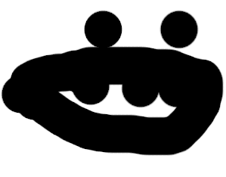
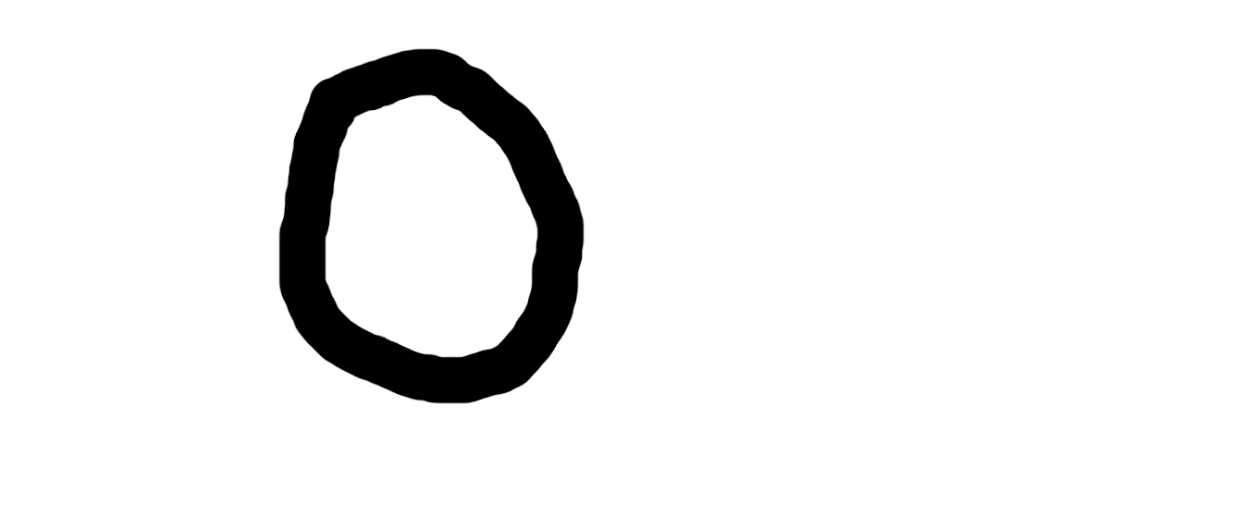
0

Slide 3
You FAILED
Try Again

Slide 5
You FAILED
Try Again

